Slide 1
MIS 631 Final ER presentation
Chetan deshpande, joseph ruben, Saran thota, steven strumolo, wenzhe song

Slide 2
Company Overview
"Our company provides flexible workspace solutions for businesses of all sizes. We operate a network of premium coworking spaces with integrated technology services and community management. Our business model centers on four key operational units:
Sales & Membership: Customer acquisition and contract management
Community Management: Member onboarding and facility maintenance
Real Estate Acquisition: Market research and property portfolio expansion
Information Technology: Technical infrastructure and support services
We create value through space optimization, member community building, and providing seamless technology integration for businesses to focus on their core operations."

Slide 3
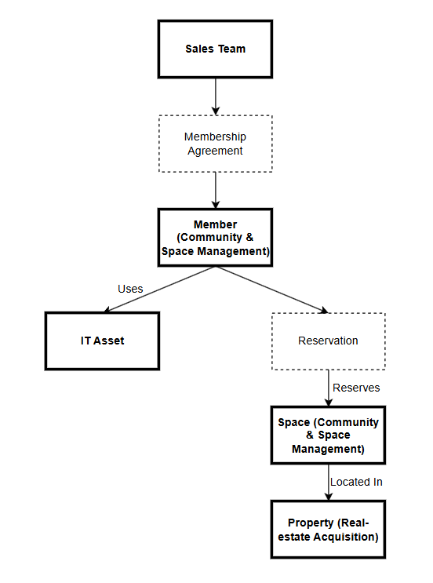
WeWork High-Level Data Model

Slide 4
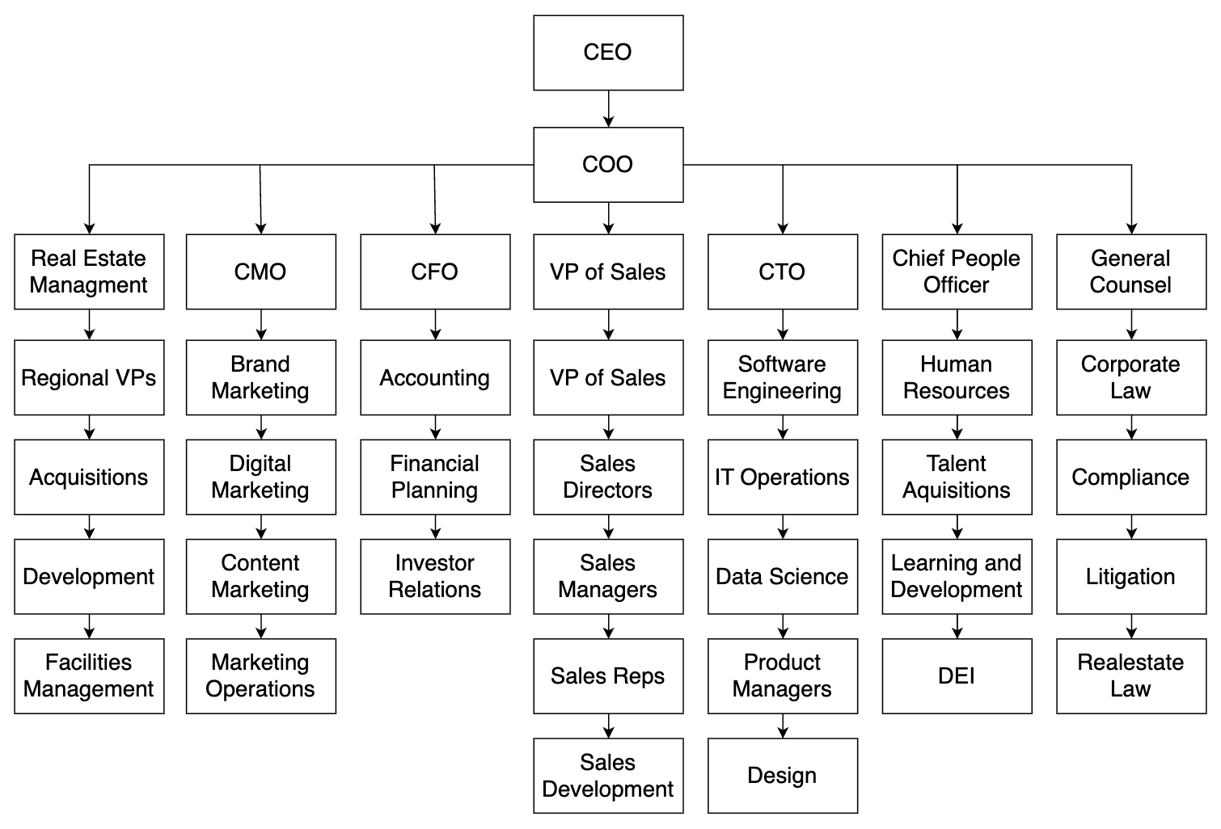
WeWork Organizational Chart

Slide 5
Sales and Membership Team – Contract Specification of the sales process
Invariant:
Lead must have valid information
Account must be linked to a lead
Contract must be linked to an opportunity
Contract must have a valid customer, location, start date, and end date
Precondition:
The company meets the qualification criteria
Creation of an account within a CRM (Customer Relationship Manager)
Lead information is obtained
Reach out to an ideal customer profile through activity (phone, email, LinkedIn)
An opportunity is stored under the Lead and Account
Contract sent to the potential client
Post-condition:
Agreement of terms and a signed contract
Onboarding process begins
Trigger:
Generation of new lead through marketing

Slide 6
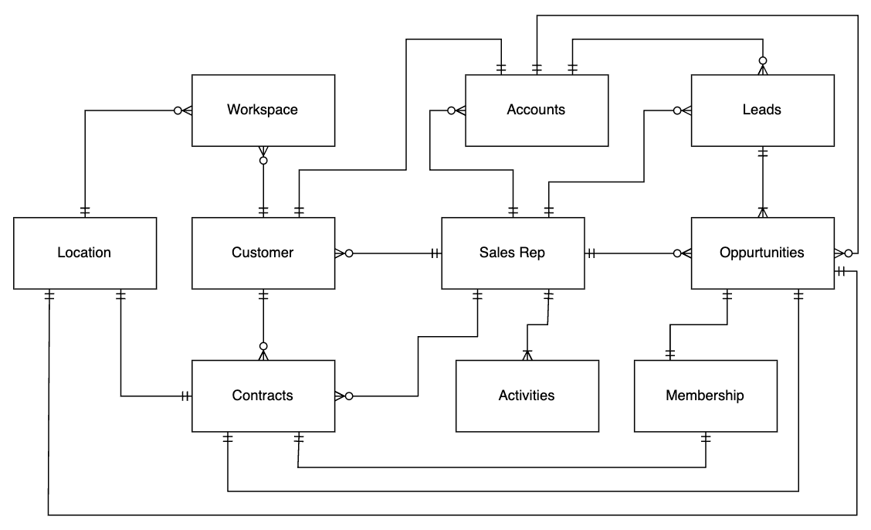
Sales and Membership Team – Consolidated Entity-Relationship Model

Slide 7
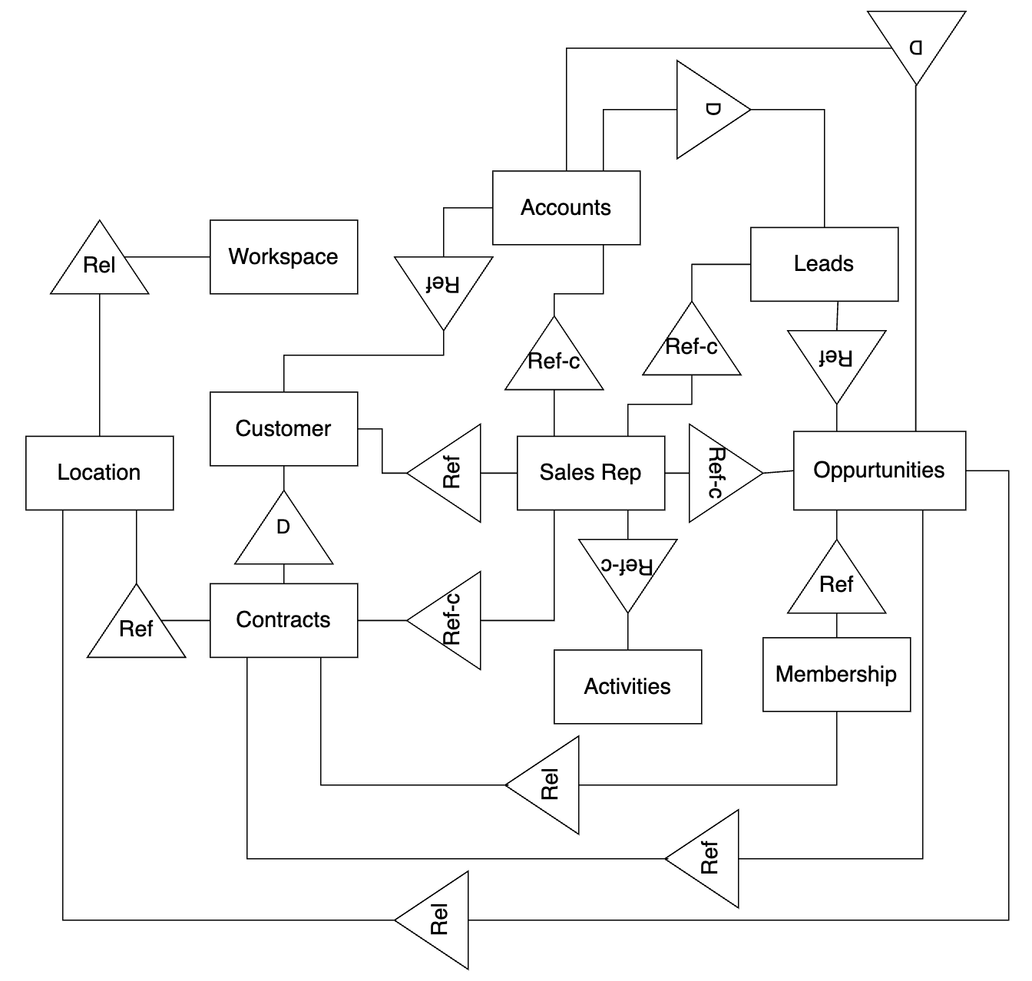
Sales and Membership Team - Information Model

Slide 8
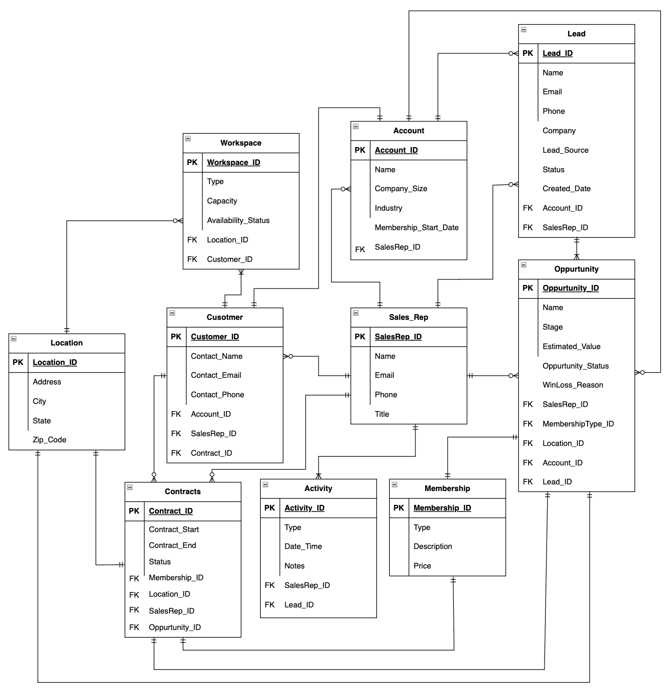
Sales and Membership Team – Fully Attributed Entity Relationship Model

Slide 9
Community & Space Management – Contract Specification of member accessing a space
Invariant:
Only members with valid access should be allowed in spaces
Precondition:
Membership must be active
Membership must include this specific space
Member must have their badge or mobile application on them
Member must scan their badge or mobile application
Post-condition:
Member is granted access to the space
Visit is logged in the system
Trigger:
The member tries entering using their badge or mobile application

Slide 10
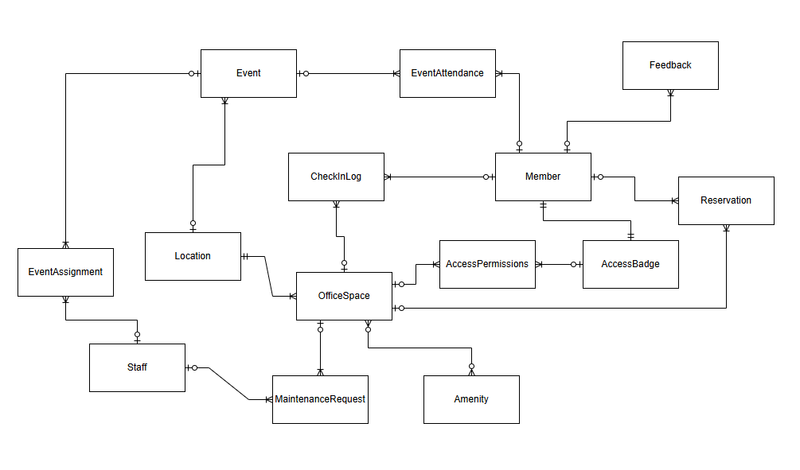
Community & Space Management – Consolidated Entity-Relationship Model

Slide 11
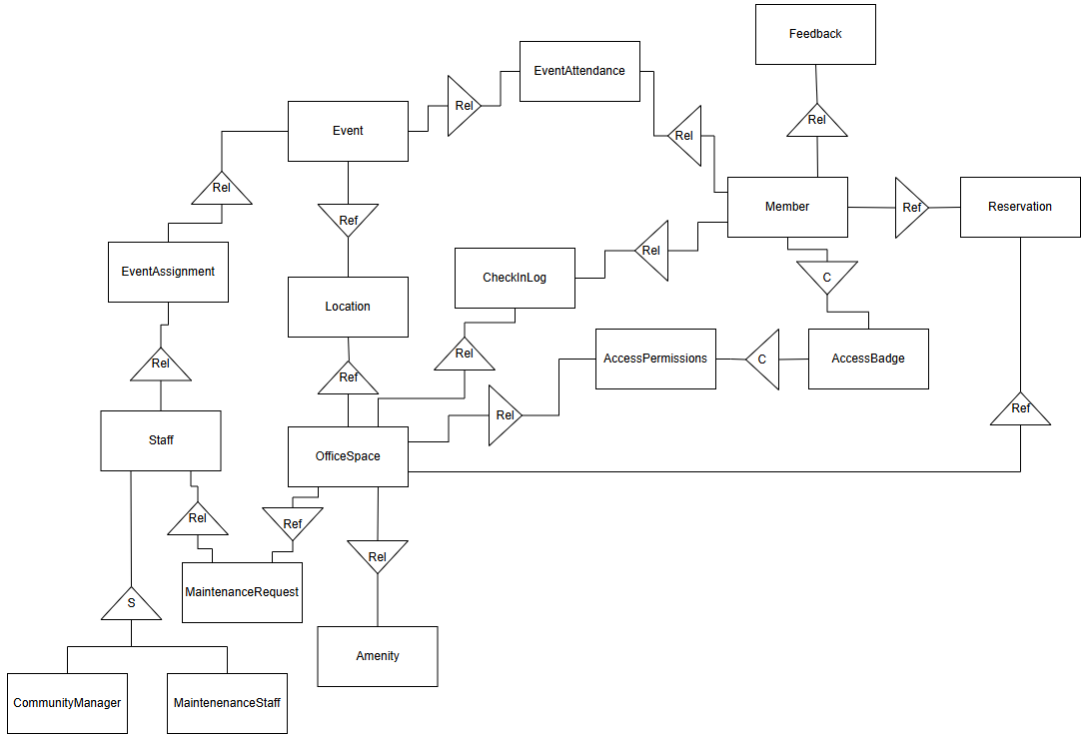
Community & Space Management – Consolidated Information Model

Slide 12
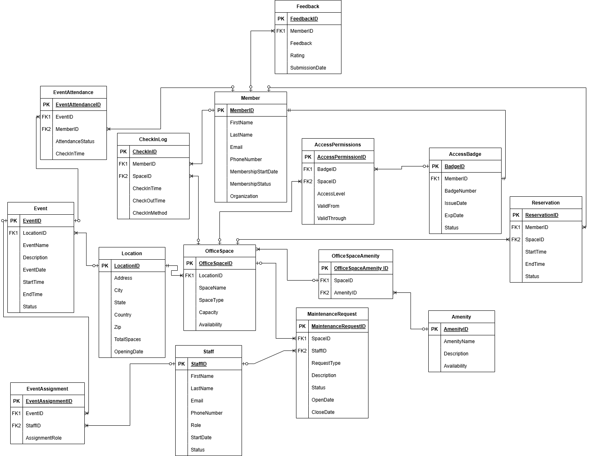
Community & Space Management – Consolidated Fully Attribute Model

Slide 13
Real-estate Aquisition – Contract Specification of lease agreement finalization
Invariant:
Construction cannot begin until there is a fully signed lease or purchase contract
Precondition:
Final lease terms have been agreed and documented
Approval from Legal and Finance departments has been received
Required signatures from internal and external parties have been obtained
Post-condition:
Fully executed lease or purchase contract is stored in the property management system
Acquisition status is updated to "Acquired"
Trigger:
The signing of the lease or purchase contract by all required parties

Slide 14
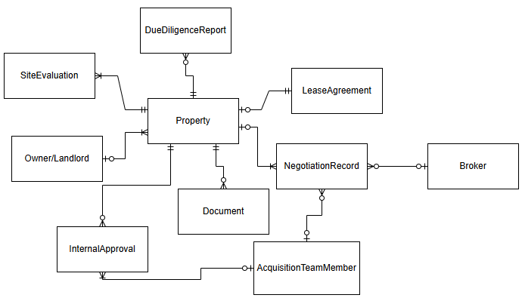
Real-estate Acquisition – Consolidated Entity-Relationship Model

Slide 15
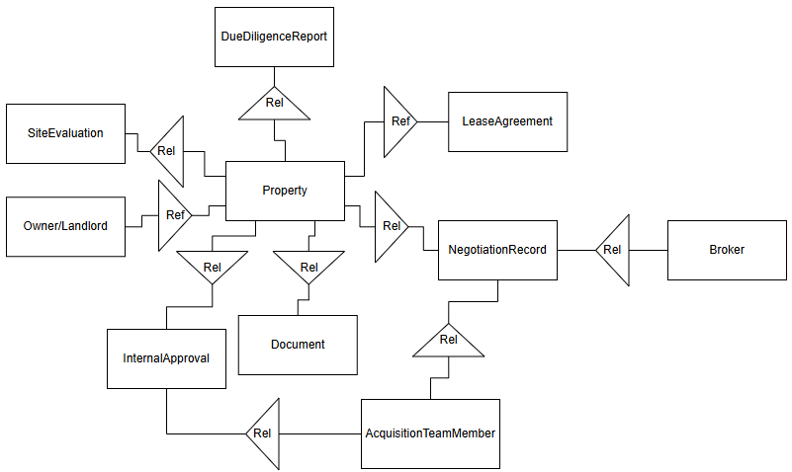
Real-estate Acquisition – Consolidated Information Model

Slide 16
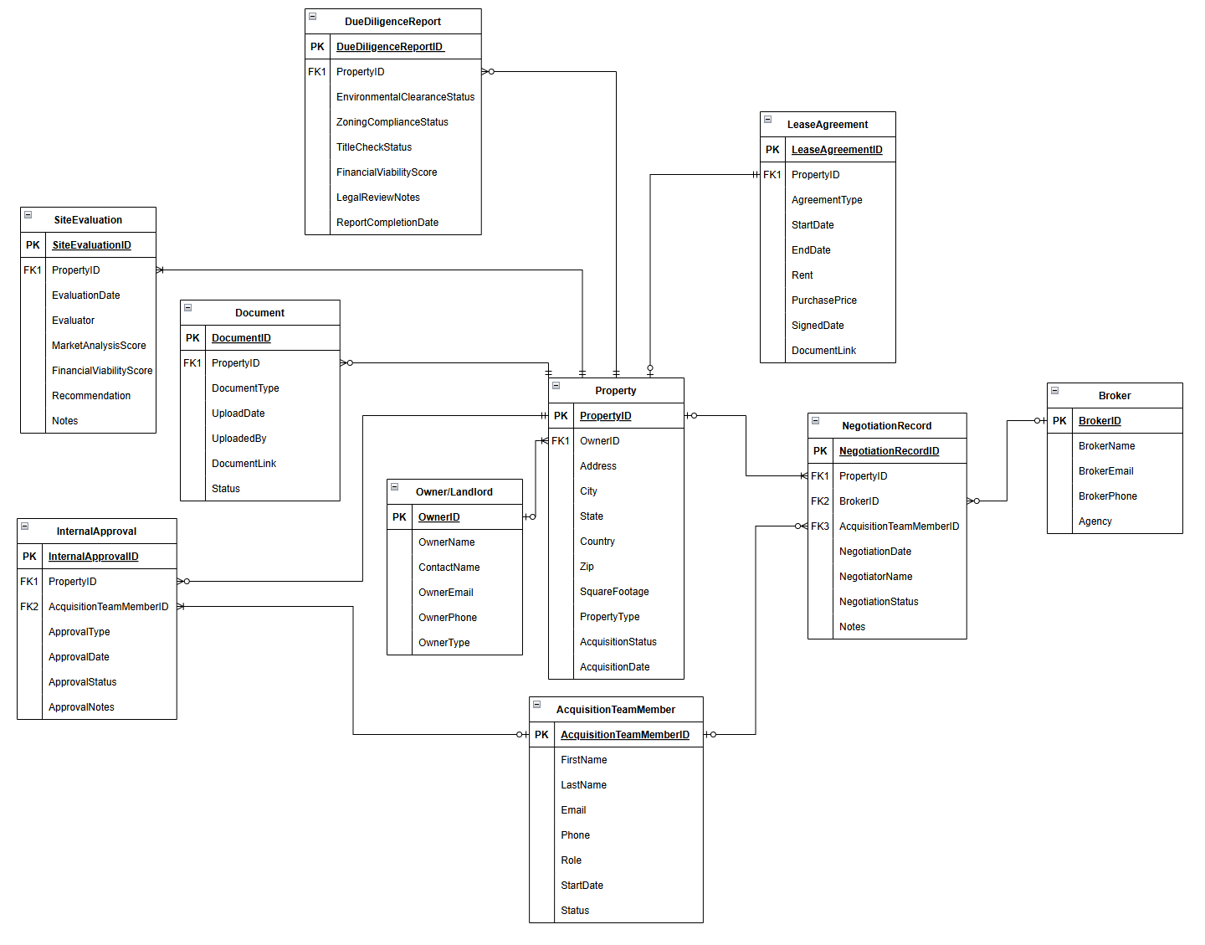
Real-estate Acquisition – Consolidated Fully Attribute Model

Slide 17
Information Technology– Contract Specification of the Technical process
Invariant:
Each operational responsibility (internet, support, or server management) is assigned exclusively to the IT department.
The IT department must comply with internal service-level agreements (SLAs) for resolution and uptime.
All service actions (tickets, server maintenance, network incidents) must be logged and auditable.
Precondition:
The IT department exists and is fully staffed with qualified personnel.
Required infrastructure (internet lines, ticketing platform, server racks, asset registry) is active and accessible.
No other department is currently managing these responsibilities.
Post-condition:
The IT department is responsible for:
Internet Management: Ensure 99% uptime with active monitoring and rapid issue resolution.
Technical Support: Provide hardware/software support via a centralized ticketing system with SLA-based response times.
Server & Data Management: Maintain secure, isolated servers, perform regular backups, and uphold data integrity.
Trigger:
A management-level directive is issued to centralize all IT operations under a single department (IT).
Increase in demand for faster response time and specialized handling of critical tech operations.

Slide 18
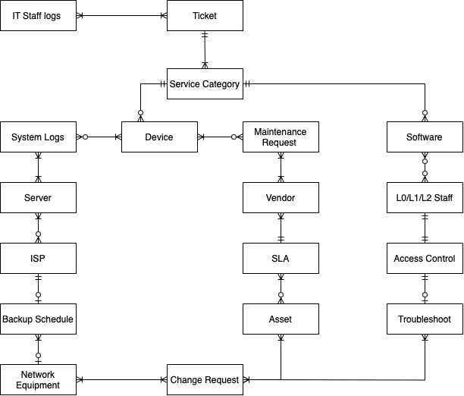
Information Technology Team – Consolidated Entity-Relationship Model

Slide 19
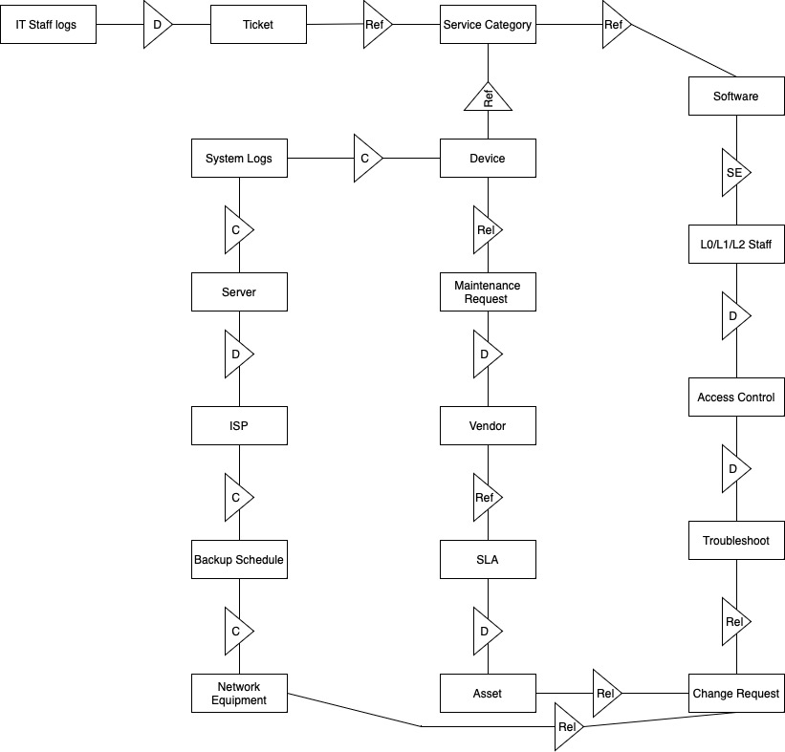
Information Technology Team - Consolidated Information Model

Slide 20
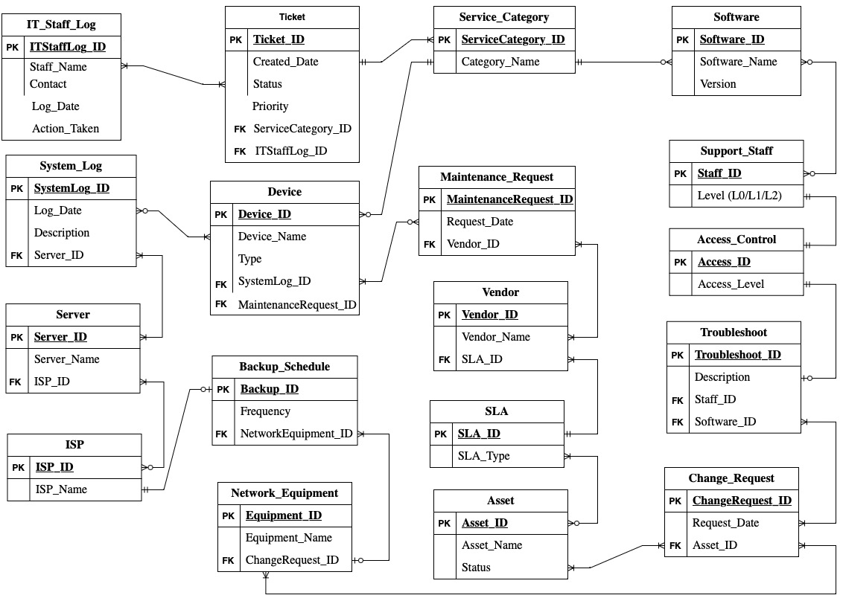
Information Technology Team – Fully Attributed Entity Relationship Model

Slide 21
Thank You

